Slide 1
Conditional Statement
Md. Shafqat Talukder Rakin
Lecturer, Dept. of CSE
United International University
Email: shafqat@cse.uiu.ac.bd
Courtesy: Tasmin Sanjida Mam

Slide 2
Program Control Statements
Control statements control the flow of execution in a program or function.
There are three kinds of execution flow:
Sequence:
the execution of the program is sequential.
Selection:
A control structure which chooses alternative to execute.
Repetition:
A control structure which repeats a group of statements.

Slide 3
Decision Making Statement
if statement
switch statement
Conditional operator statement
goto statement
They are also known as control statements.

Slide 4
Different forms of if statement
Simple if statement
if....else statement
Nested if......else statement
else if ladder

Slide 5
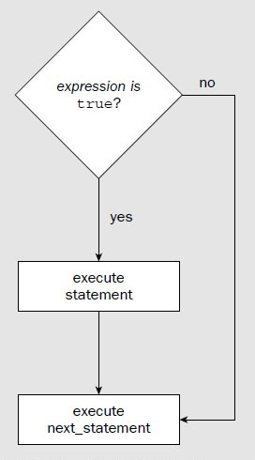
BECOME FAMILIAR WITH THE if
In its simplest form, the if statement allows our program to conditionally execute a statement.
Its operation is governed by the outcome of a conditional test evaluates to either true or false.

Slide 6
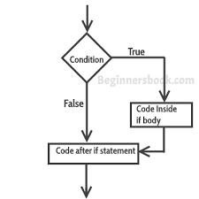
If Statement

Slide 7
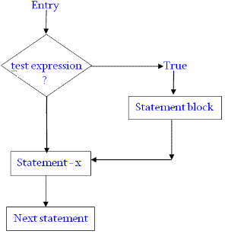
If….
The expression may be any valid C expression.
If the expression evaluated as true, the statement will be executed.
If it does not - the statement is bypassed and the line of code following the if is executed.

Slide 8
If Statement
if(Conditions){
------------------
-----------------
}

Slide 9
if....
In C, an expression is true if it evaluates to any nonzero value.
If it evaluate to zero, it is false.

Slide 10
What will happen?
int a=10, b=20;
if(a < b)
printf(“This line will print.”);
Output
This line will print.

Slide 11
What will happen?
int a=10, b=20;
if( a > b)
printf(“This line will print.”);
Output
Nothing!

Slide 12
What will happen?
int a=10, b=20;
printf(“%d”, a<=b);
Output
1

Slide 13
ADD THE else!
We can add else statement to the if.
The if…else statement is an extension of the simple if statement.
if(test expression)
{
True-block statement(s)
}
else
{
False-block statement(s)
}
Statement x

Slide 14
If Statement
if(Conditions){
------------------
-----------------
}
else{
---------------
-----------------
}

Slide 15
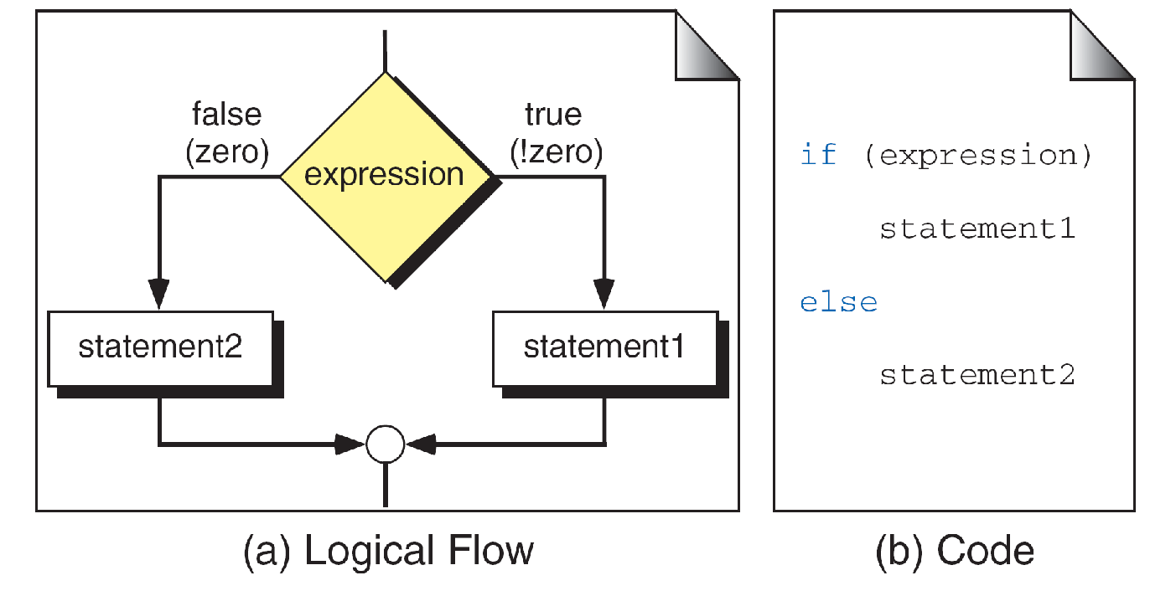
ADD THE else!
Which number is greater?

Slide 16

Program that will decide whether a number is positive or not.
How do you understand if a number is positive or negative?

Slide 17
Program that will decide whether a number is positive or not.
Positive if Number>0
Negative if Number <0

Slide 18
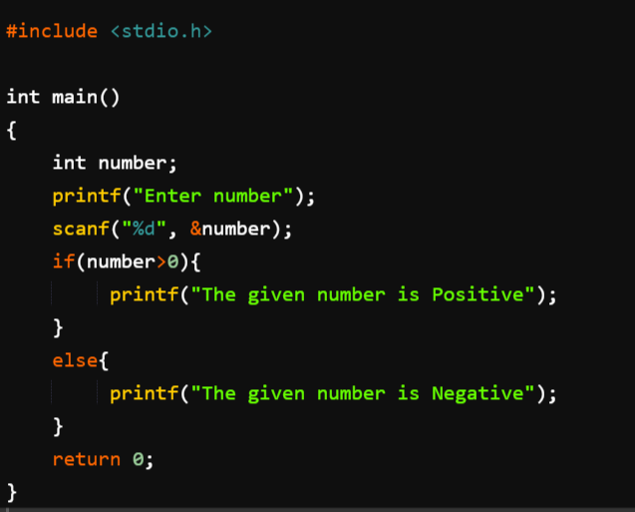

Program that will decide whether a number is positive or not.

Slide 19



Remember!!!
The result/value produce by the relational and logical operators is either 0 or 1.
It produce 1 for true
And 0 for false.
Should Tani buy this?
Should they buy this?

Slide 20
Program that will decide whether a number is positive or not or neither positive nor negative.

Slide 21
If Statement
if(Conditions){
------------------
}
else if(Conditions){
---------------
}
else{
-----------------
}

Slide 22
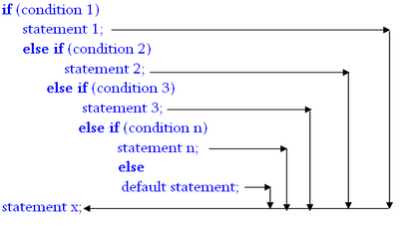
if…else Ladder!
Which number is greater?

Slide 23
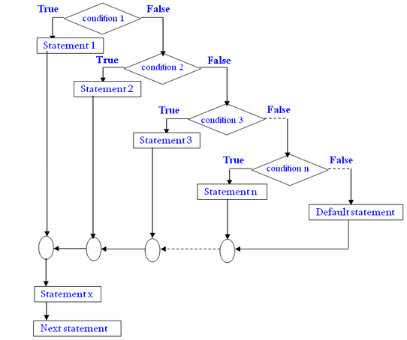
if…else Ladder!
Notes:
Grade Example Page-124 (ANSI C)

Slide 24

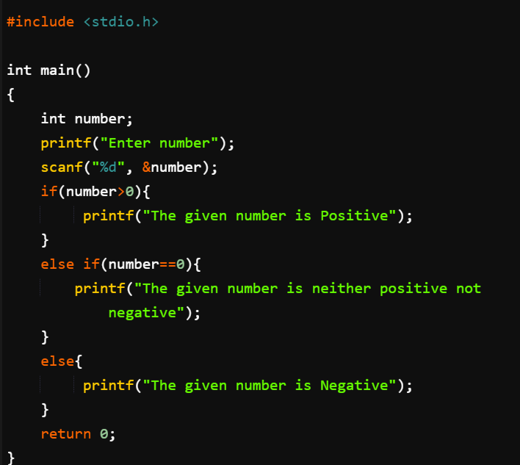
Program that will decide whether a number is positive or not.

Slide 25
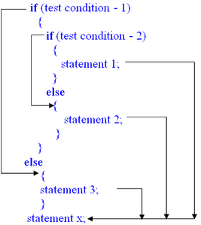
Nested if…else

Slide 26
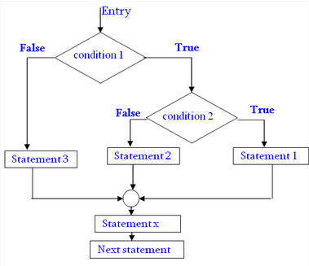
Nested if…else

Slide 27
Program to find the greatest digit from three digits

Slide 28
Program to find the greatest digit from three digits
a,b,c
a bigger: a>b & a>c
b bigger: b>a & b>c
Else c is bigger

Slide 29
Program to find the greatest digit from three digits
#include <stdio.h>
int main()
{
int dig1, dig2, dig3;
printf("Enter three numbers: ");
scanf("%d%d%d", &dig1, &dig2, &dig3);
if(dig1 > dig2){
if(dig1 > dig3){
printf("dig1 is the maximum");
}
else{
printf("dig3 is the maximum");
}
}
else
{
if(dig2 > dig3)
{
printf("dig2 is the maximum");
}
else
{
printf("dig3 is the maximum");
}
}
return 0;
}

Slide 30
Nested if…else
Problem!
A commercial bank has introduced an incentive policy of giving bonus to all its deposit holders. The policy is as follows: A bonus of 2 per cent of the balance held on 31st December is given to every one, irrespective of their balance, and 5 per cent is given to female account holders if their balance is more than Tk. 50,000.

Slide 31
Nested if…else
Problem!
A commercial bank has introduced an incentive policy of giving bonus to all its deposit holders. The policy is as follows: A bonus of 2 per cent of the balance held on 31st December is given to every one, inspective of their balance, and 5 per cent is given to female account holders if their balance is more than Tk. 50,000.

Slide 32
Conditional Operators
exp1 ? exp2 : exp3
We will discuss it in slide 5!

Slide 33
The Conditional Operator
(? : )
the conditional operator
A conditional expression is written in the form
expression 1 ? expression 2 : expression 3
True or False?
True
False

Slide 34
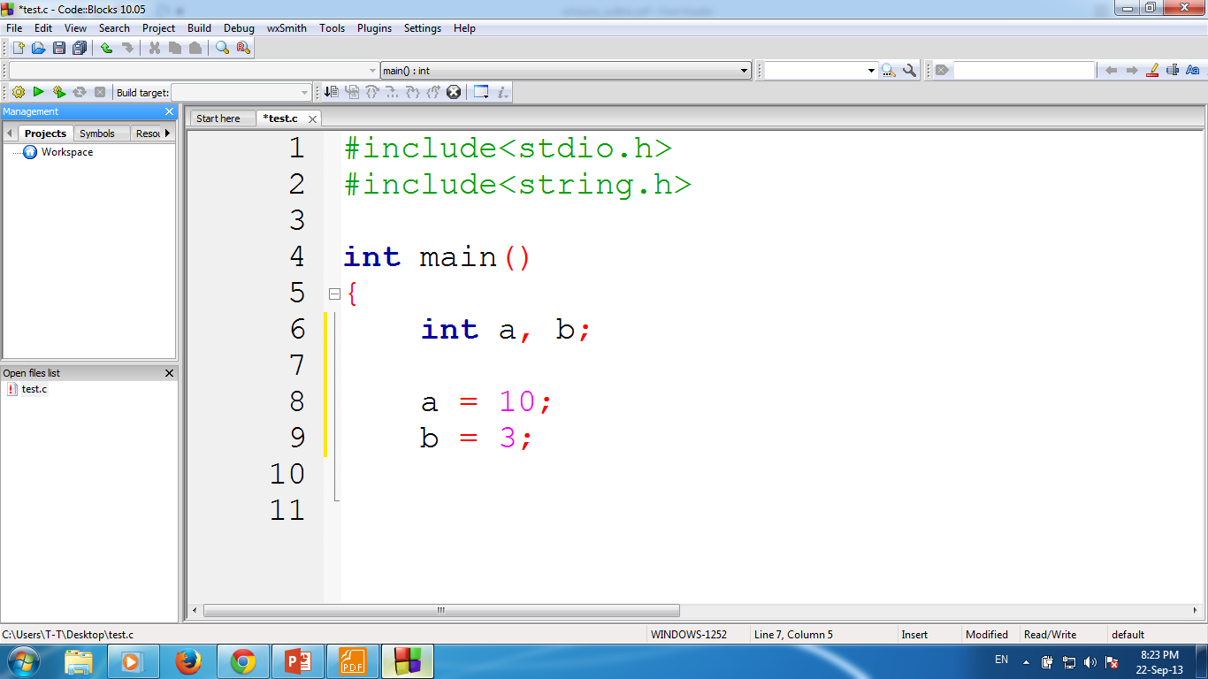
The Conditional Operator
(a + b) >= 13 ? a = 100 : a = 1000
True or False?
True

Slide 35
The Conditional Operator
i = (a+b)<13 ? 100 : 1000
True or False?
False

Slide 36
SELECT ALTERNATIVE WITH THE switch STATEMENT
If is good for choosing between two alternatives
When several alternatives are needed we should use switch statement.
switch is C’s multiple selection statement.
Use to select one of several alternative paths in program execution

Slide 37
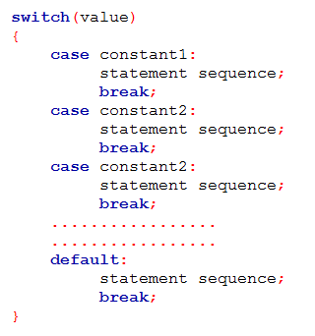
How it works?
A value is successively tested against a list of integer or character constants.
When the match is found, the statement sequence associated with that match is executed.
Statement sequence are not blocks, not use curly braces

Slide 38
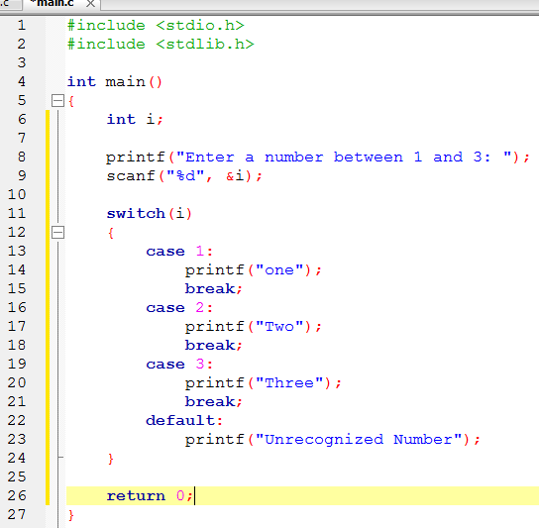
Example - switch
Notes:
Grade System Program: A->Excellent! B->Good C->OK D->You just Pass the exam F->Better try next time

Slide 39
if vs switch
switch can only test for equality, where the if conditional expression can be of any type
switch will work with only int or char types. We can’t use float or others.

Slide 40
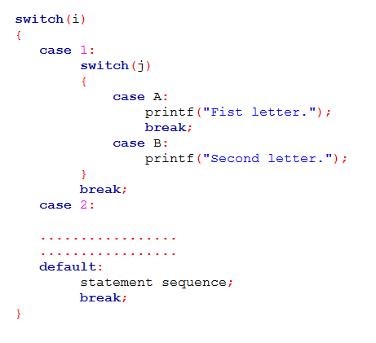
Nested switch!

Slide 41
goto Statement
Guess what I am going to say!
We will learn later!

